Slide 1
We get 3 types of behaviour out of the experiment.

Slide 2
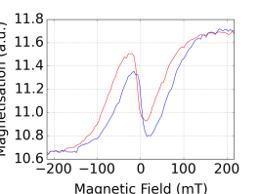
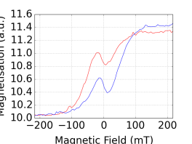
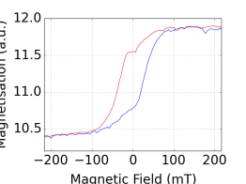
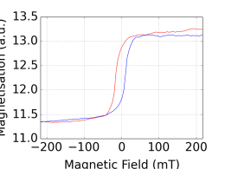
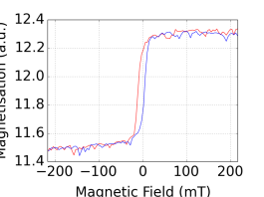
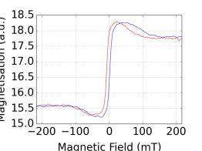
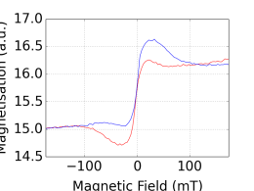
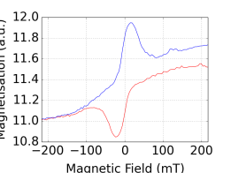
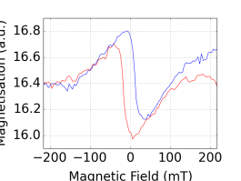
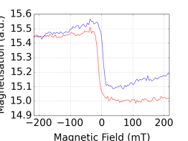
A: Gd flip: At low T, N-shape Ni hysteresis loop. At high T, Gd hysteresis loop goes from following the field to against the field, N shape of Ni disappear.
5K
15K
20K
30K
75K
Ni:
Gd:
(S1)

Slide 3
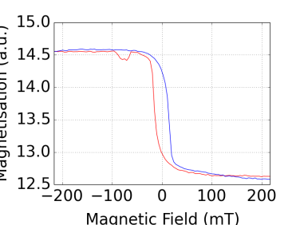
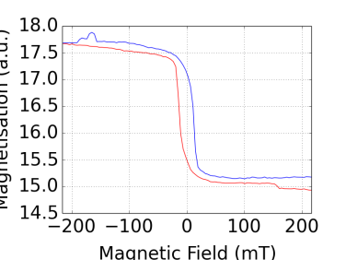
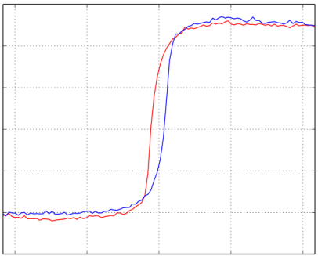
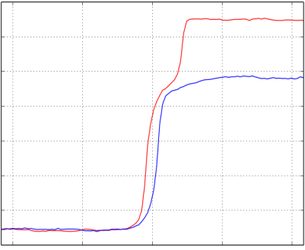
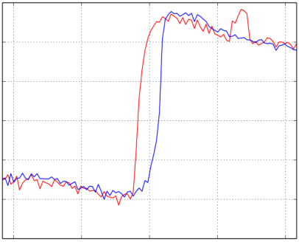
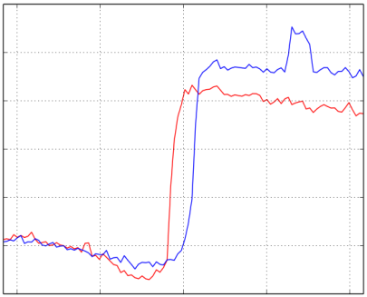
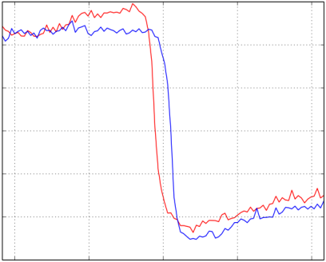
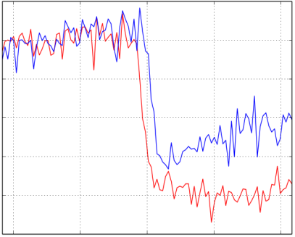
B: Both flip: At low T, Gd follows the field and Ni against the field. At higher T, both flip.
5K
20K
30K
55K
Ni:
Gd:
(S14)

Slide 4
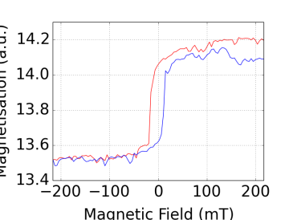
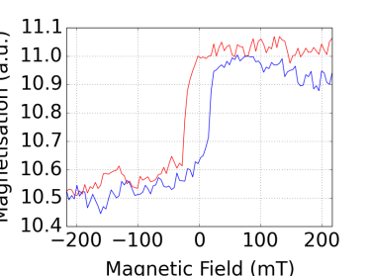
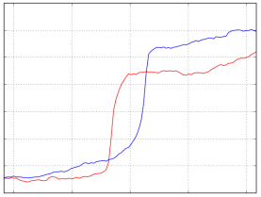
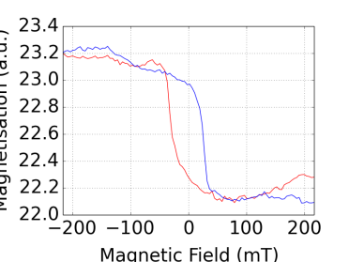
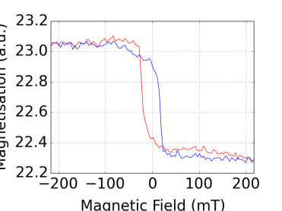
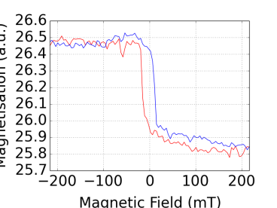
C: Neither flip: Ni and Gd stays antiparallel throughout field range with Ni align to the field.
8K
40K
75K
Ni:
Gd:
(S2)

Slide 5
 | S1 | S2 | S3 | S4 | S5 | S6 | S7 | S8 | S9 | S10 | S11 | S12 | S13 | S14 | S15
Ni | 3.6 | 2.5 | 3.9 | 2.7 | 3.7 | 2.4 | 6.5 | 4.2 | 2.6 | 2.9 | 1.4 | 1.9 | 3.1 | 3.8 | 2.2
Gd | 11.4 | 4.6 | 6 | 2.6 | 21.5 | 11.1 | 20.8 | 11.1 | 6.2 | 6.1 | 8.2 | 6.2 | 7.9 | 11.1 | 9.7
Ni | 3.6 | 2.5 | 3.9 | 2.7 | 3.7 | 2.4 | 6.5 | 4.2 | 2.6 | 2.9 | 1.4 | 1.9 | 3.1 | 3.8 | 2.2
Beha-viour | A | C | A | C | B | B | A | A | B* | B* | B* | B* | B | B | B*
A: Gd flip. Ni has ‘N-shape’ at low temperature
B: Both flip.
C: Neither flip.
(Those with B* have behaviours similar to B. but is very hard to determine due to large fluctuations in the data obtained)

Slide 6
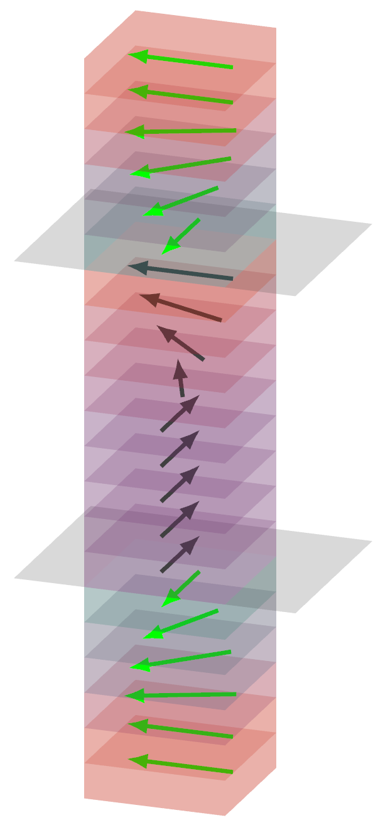
Basic theory: Assuming the tri-layers is consisting of stacks of thin layers of materials with their magnetic moments constraint in their planes.

Slide 7
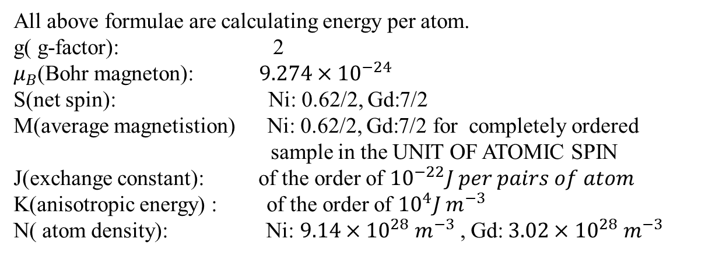
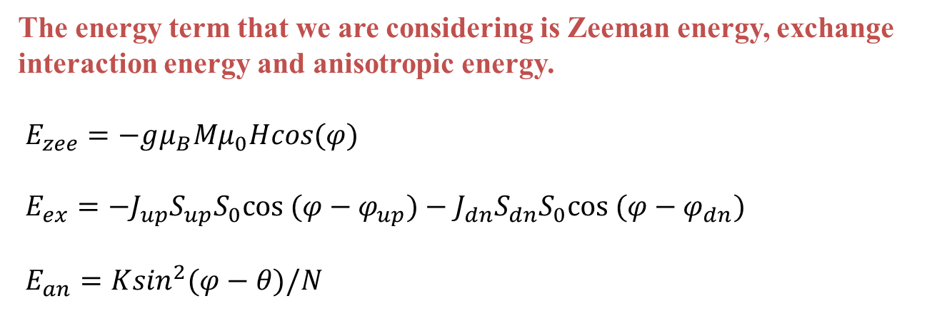
The energy term that we are considering is Zeeman energy, exchange interaction energy and anisotropic energy.
$E_{zee}=−gμ_{B}Mμ_{0}Hcos(φ)$
$E_{ex}=−J_{up}S_{up}S_{0}cos (φ−φ_{up})−J_{dn}S_{dn}S_{0}cos (φ−φ_{dn})$
$E_{an}=K\sin^{2}(φ−θ)/N$
All above formulae are calculating energy per atom.
g( g-factor): 2
$μ_{B}$(Bohr magneton): $9.274×{10}^{−24}$
S(net spin): Ni: 0.62/2, Gd:7/2
M(average magnetistion) Ni: 0.62/2, Gd:7/2 for completely ordered
sample in the UNIT OF ATOMIC SPIN
J(exchange constant): of the order of ${10}^{−22}J per pairs of atom$
K(anisotropic energy) : of the order of ${10}^{4}J m^{−3}$
N( atom density): Ni: $9.14×{10}^{28} m^{−3}$, Gd:$3.02×{10}^{28} m^{−3}$

Slide 8
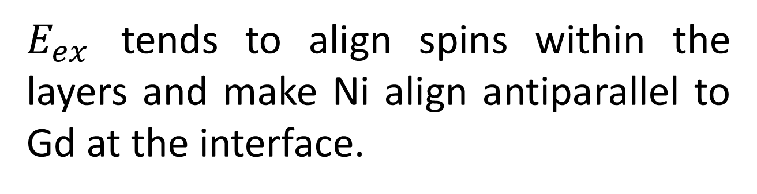
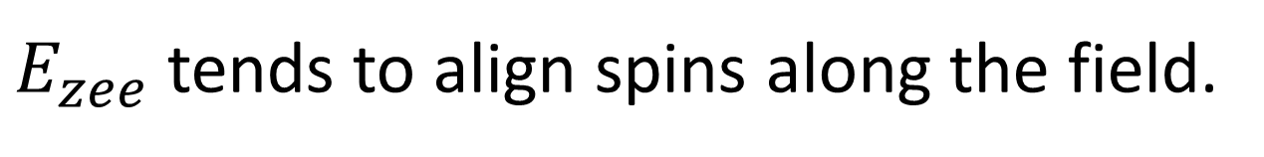
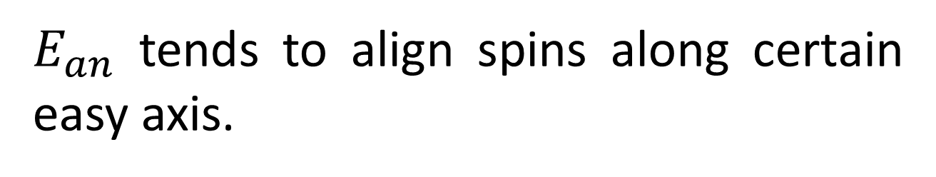
$E_{zee}$ tends to align spins along the field.
$E_{ex}$ tends to align spins within the layers and make Ni align antiparallel to Gd at the interface.
$E_{an}$ tends to align spins along certain easy axis.

Slide 9
Qualitative explanation of behaviour A

Slide 10





$$T_{1}$$
$$T_{2}$$
$$T_{3}$$
Gd:
Ni:
Only the backward hysteresis curve is shown here.
$$T_{4}$$
$$T_{5}$$

Slide 11
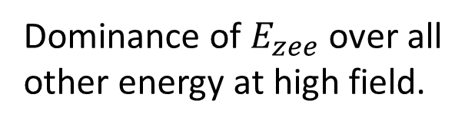
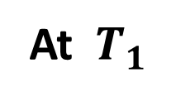
V
IV
III
II
I
At $T_{1}$
Gd
Ni
Dominance of $E_{zee}$ over all other energy at high field.
Stage I:

Slide 12
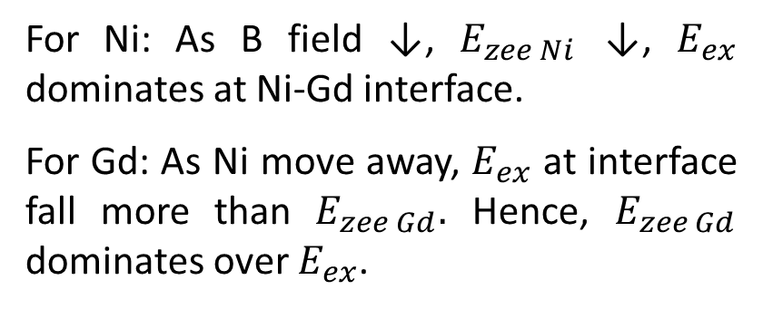

V
IV
III
II
I
$$T_{1}$$
Gd
Ni
For Ni: As B field ↓, $E_{zee Ni}$ ↓, $E_{ex}$ dominates at Ni-Gd interface.
For Gd: As Ni move away, $E_{ex}$ at interface fall more than $E_{zee Gd}.$ Hence, $E_{zee Gd}$ dominates over $E_{ex}$.
I→II:
II:

Slide 13
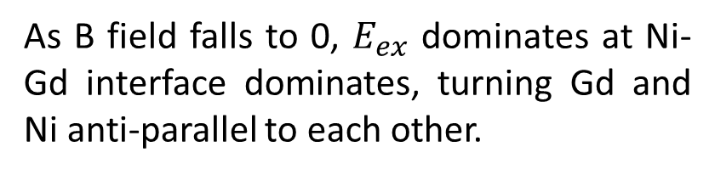
V
IV
III
II
I
$$T_{1}$$
Gd
Ni
II→III:
As B field falls to 0, $E_{ex}$ dominates at Ni-Gd interface dominates, turning Gd and Ni anti-parallel to each other.
III:

Slide 14
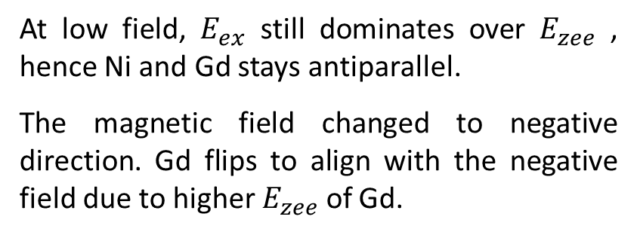
V
IV
III
II
I
$$T_{1}$$
Gd
Ni
At low field, $E_{ex}$ still dominates over $E_{zee}$ , hence Ni and Gd stays antiparallel.
The magnetic field changed to negative direction. Gd flips to align with the negative field due to higher $E_{zee}$ of Gd.
III →IV:
IV:

Slide 15
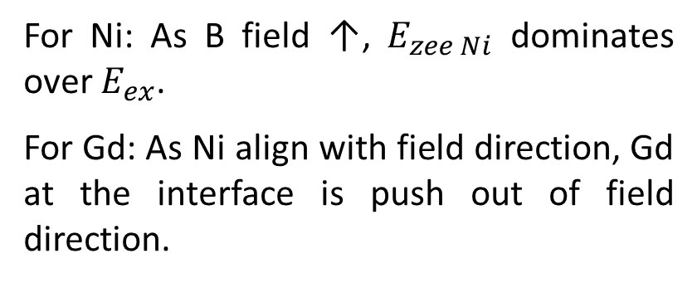
V
IV
III
II
I
$$T_{1}$$
Gd
Ni
For Ni: As B field ↑, $E_{zee Ni}$ dominates over $E_{ex}$.
For Gd: As Ni align with field direction, Gd at the interface is push out of field direction.
IV →V:
V:

Slide 16
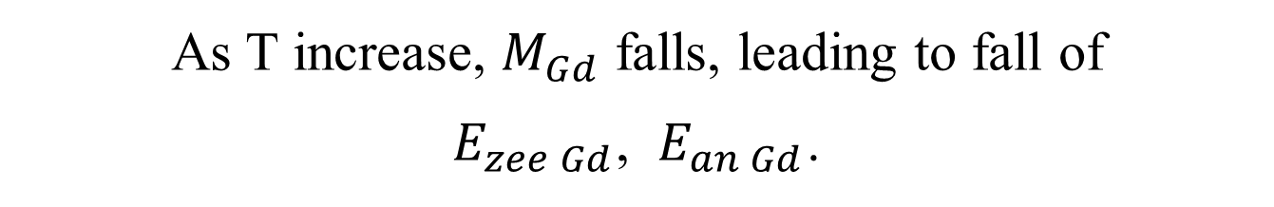
The Curie temperature of bulk Gd is 292K, that of Ni is 627K.
Hence, for the temperature range that we are investigating (usually between 5K to 70K), we can assume:
average magnetisation of Gd layers falls with increasing temperature
average magnetisaion of Ni stays relatively constant.
As T increase, $M_{Gd}$ falls, leading to fall of
$E_{zee Gd}$, $E_{an Gd}$.
All description about the energy terms like ‘increase’, ’fall’, ‘high’, ‘low’, etc. from now on are referring to the MAGNITUDE of the energy terms

Slide 17
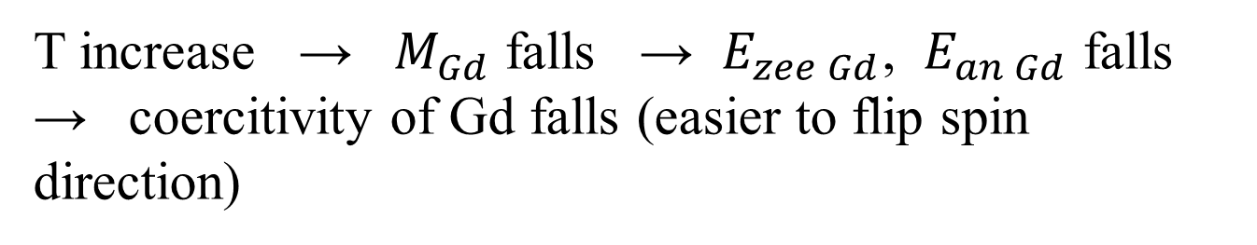
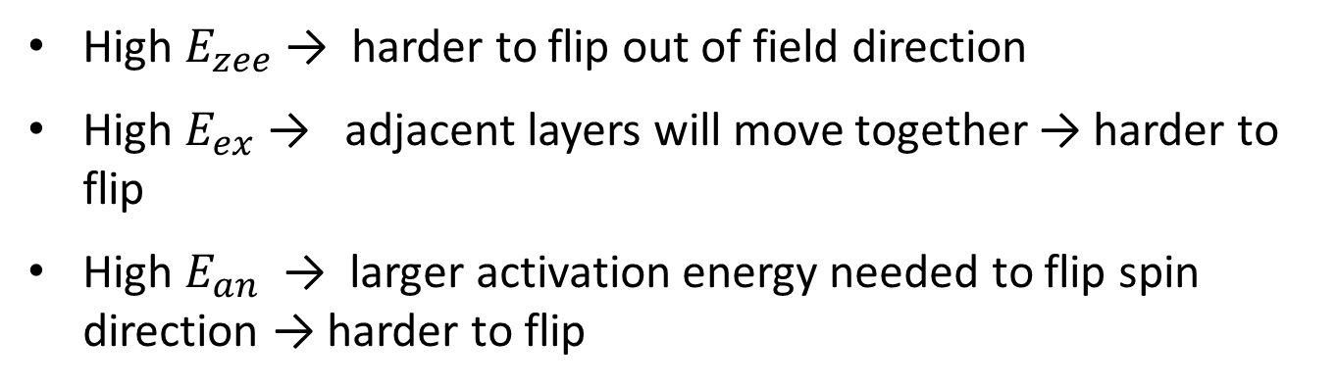
High $E_{zee}$ → harder to flip out of field direction
High $E_{ex}$ → adjacent layers will move together → harder to flip
High $E_{an}$ → larger activation energy needed to flip spin direction → harder to flip
T increase → $M_{Gd}$ falls → $E_{zee Gd}$, $E_{an Gd}$ falls → coercitivity of Gd falls (easier to flip spin direction)

Slide 18
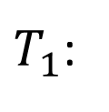
V
IV
III
II
I
$$T_{1}$$
Gd
Ni
I
II
III
IV
V
$T_{1}$:

Slide 19
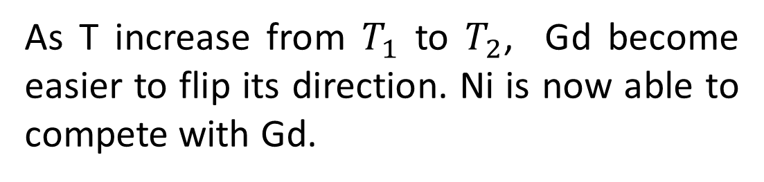
As T increase from $T_{1}$ to $T_{2}$, Gd become easier to flip its direction. Ni is now able to compete with Gd.

Slide 20

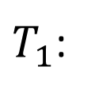
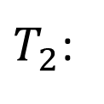
V
IV
III
II
I
Coercitivity of Ni is now able to compete with Gd.
Ni will turn a smaller angle in II→III and III→IV, leading to smaller peaks.
Gd will be push more out of field direction when Ni align with the field, leading to lower magnitude in region I-II and IV-V.
$$T_{2}$$
Gd
Ni
I
II
III
IV
V
$T_{1}$:
I
II
III
IV
V
$T_{2}$:
Notes:
At $T_{2}$, the coercivity of Ni and Gd are much closer. From stage I to II, there is not only turning of Ni, but also to some extent turning of Gd. Hence, Gd(2) is less positive, Ni(2) is less negative. For the same reason Ni(3) becomes less positive as well after T increase. When Ni flip from III to IV, more Gd at the interface is pushed out of the field direction, causing a rise of the region between Gd(4) and Gd(5).

Slide 21
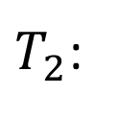

$$T_{2}$$
V
IV
III
II
I
Gd
Ni
I
II
III
IV
V
$T_{2}$:

Slide 22
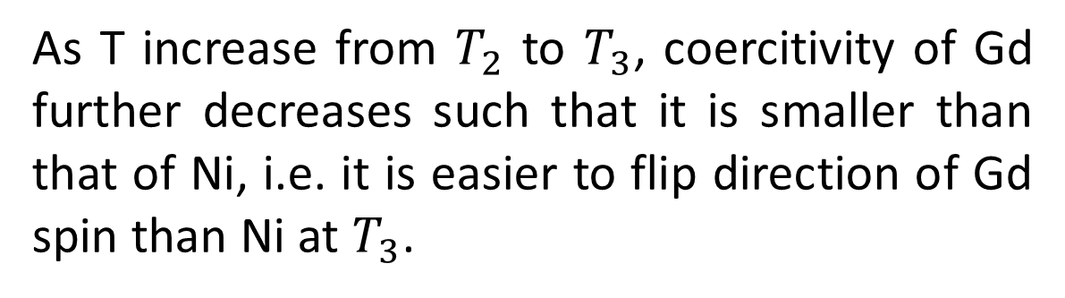
As T increase from $T_{2}$ to $T_{3}$, coercitivity of Gd further decreases such that it is smaller than that of Ni, i.e. it is easier to flip direction of Gd spin than Ni at $T_{3}$.

Slide 23

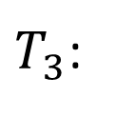
V
IV
III
II
I
$$T_{3}$$
Coercitivity of Ni has exceeded that of Gd.
Ni will stay roughly along positive field direction in region I-IV.
Gd will flip in region I-III instead of Ni. Gd will get more pushed out of field direction in region IV-V.
Gd
Ni
I
II
III
IV
V
$T_{2}$:
I
II
III
IV
V
$T_{3}$:

Slide 24

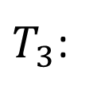
V
IV
III
II
I
$$T_{3}$$
Gd
Ni
I
II
III
IV
V
$T_{3}$:

Slide 25
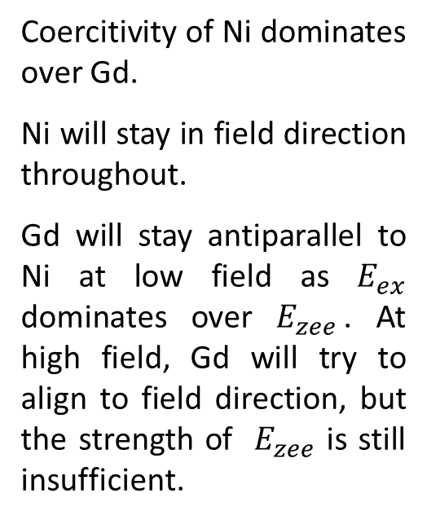

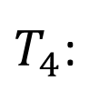
V
IV
III
II
I
Coercitivity of Ni dominates over Gd.
Ni will stay in field direction throughout.
Gd will stay antiparallel to Ni at low field as $E_{ex}$ dominates over $E_{zee}$. At high field, Gd will try to align to field direction, but the strength of $E_{zee}$ is still insufficient.
$$T_{4}$$
Gd
Ni
I
II
III
IV
V
$T_{3}$:
I
II
III
IV
V
$T_{4}$:

Slide 26

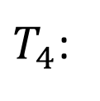
$$T_{4}$$
IV
III
II
I
Ni
Gd
I
II
III
IV
$T_{4}$:

Slide 27




$$T_{5}$$
IV
III
II
I
Coercitivity of Ni dominates over Gd.
Ni will stay in field direction throughout.
$E_{ex }$will dominates over $E_{zee Gd}$, so that Gd will stay anti-parallel to Ni throughout
Ni
Gd
I
II
III
IV
$T_{4}$:
I
II
III
IV
$T_{4}$:

Slide 28


$$T_{5}$$
IV
III
II
I
I
II
III
IV
$T_{4}$:

Slide 29
Simulation of behaviour A

Slide 30

General idea:
Using initial angle $φ_{0}$ of each layer and its adjacent layers, we obtain the angle with the minimum energy $φ_{min}$ for each layer by calculating $E_{zee}$, $E_{an}$ and $E_{ex}$. Repeat the process for the whole stack.
Setting $φ_{min}$ as the new $φ_{0}$, and repeat the process until the stack configuration no longer changes, reaching a stationary point.
Using the configuration to obtain magnetisation and plot out the hysteresis curve.

Slide 31
1. Global energy minimum or local energy minimum:
If it is global minimum, then the pattern of hysteresis loop should be entirely centrosymmetric because the behavior in negative field should be exactly same as that in positive field except for a change of direction. In the experimental data, we found some non-centrosymmetric pattern, hence the behavior of the hysteresis loop should be based on local minimum.

Slide 32

2. Temperature dependence:
As mentioned before, we are assuming a falling $M_{Gd}$ for increasing T
For A behaviour, At high T we want flipping of Gd, which means Gd and Ni need to stay antiparallel through the whole H range, which means we need $E_{ex}$ to be dominant at high T through the whole field range.

Slide 33

2. Temperature dependence:
We note that $E_{zee}$ of the layer can be calculated from its macroscopic magnetisation. Hence, when T rises, average magnetisation of the layers fall, $E_{zee}$ will also fall accordingly.
However, $E_{ex}$ arises from microscopic phenomenon. It depends on spin S, not magnetistion M. Even if the average magnetisation of adjacent layers have fallen, microscopically, the adjacent spins may still line up as strongly. That is to say, the 2 adjacent layers will have their microscopic spins randomised in similar fashion. Hence, $E_{ex}$ is acturally much less dependent on T. In this case, we will assume $E_{ex}$ is independent of T.
Using Formula 12.73 of Physics of Ferromagnetism, we will assume anisotropic constant K varies to the cube of magnetisation in the case of uniaxial anisotropy (Gd).

Slide 34

2. Temperature dependence:
In summary:
$S_{Ni}$, $S_{Gd}$ and $M_{Ni}$ doesn’t vary with temperature.
$M_{Gd}$ falls with increasing temperature.
And we have:
$E_{ex Gd}$ independent of $M_{Gd}$.
$E_{zee Gd}∝M_{Gd}$
$E_{an Gd}∝{M_{Gd}}^{3}$

Slide 35
3. Simplification of structure:
We will assume the [111] direction of fcc Ni align with the c axis of the hcp Gd. The inter-planar spacing of Ni is around 0.2nm, that of Gd is around 0.3nm. Considering the density of atom of Ni is about 3 times of that of Gd, hence the atom density of planes of Ni is about twice of that of Gd. Hence, we double the spin of Ni when we considering the layered model.
S(net spin): Ni: 1.3/2, Gd:7/2

Slide 36
4. Symmetry of the stack:
The stacks has top and bottom mirror symmetry. Hence, in the simple model that we considered, the spin configuration of the bottom half of the stack should be same as the bottom half. Hence, when running the program, we only need to get the optimum configuration of half of the stack (making it actually identical to bilayer model).

Slide 37

5. Different order of iteration:
When we obtain the $φ_{min}$ of the layer, we sub $φ_{min}$ right in to be the new $φ_{0}$, and calculate $φ_{min}$ of adjacent layers base on the new $φ_{0}$. This method is fast, but the result may depends on which layer we calculate the $φ_{min}$ and sub in first.
We can also calculate the $φ_{min}$ of all the layers, then sub them at the same time as the new $φ_{0}$. The result is independent of the order of the layer, but it is slower. This is the method that we adopt.

Slide 38







6. Simplification of $E_{an}$:
$E_{ex}$, $E_{zee}$ (at 0.1T) and $E_{an}$ is in the order of ${10}^{−22}$, ${10}^{−24}$ and ${10}^{−25}$ J per atom respectively. Hence, $E_{an}$ is small compared to $E_{ex}$ and $E_{zee}$. Hence we can make approximation of $E_{an}$ without greatly influence the result.
The spin usually stays around the energy minimum region. In those region of interest, $−|cos\left(φ−θ\right)|$ is a very good approximation of $\sin^{2}(φ−θ)$.
$$E_{an}=\frac{K}{N}\sin^{2}(φ−θ)$$
$$E_{an}=−\frac{K}{N}|cos\left(φ−θ\right)|$$
$$θ$$
$$π+θ$$
$$θ$$
$$π+θ$$

Slide 39

Obtaining $φ_{min}$ of the layer analytically
We divide into 2 situation:
$φ_{min}<\frac{1}{2}π+θ$ or $φ_{min}≥\frac{3}{2}π+θ$, for which $E_{an}=−\frac{K}{N}cos\left(φ−θ\right)$
$\frac{1}{2}π+θ≤φ_{min}<\frac{3}{2}π+θ$, for which $E_{an}=\frac{K}{N}cos\left(φ−θ\right)$

Slide 40


If we assume situation 1 is true: $φ_{min}<\frac{1}{2}π+θ$ or $φ_{min}≥\frac{3}{2}π+θ$,
$E_{tot}=E_{zeeman}+E_{ex}+E_{an}$
$=−gμ_{B}Mμ_{0}Hcos\left(φ\right)−{J_{up}S}_{up}S\cos\left(φ−φ_{up}\right)$ $−{J_{dn}S}_{dn}S\cos\left(φ−φ_{dn}\right)−\frac{K}{N}cos\left(φ−θ\right)$
By setting
$$A_{cos}=S\left({J_{up}S}_{up}cosφ_{up}+{J_{dn}S}_{dn}cosφ_{dn}\right)$$
$$A_{sin}=S\left({J_{up}S}_{up}sinφ_{up}+{J_{dn}S}_{dn}sinφ_{dn}\right)$$
$$C=gμ_{B}Mμ_{0}H$$
$$D_{sin}=\frac{Ksinθ}{N}$$
$$D_{cos}=\frac{Kcosθ}{N}$$

Slide 41


We have:
$$E_{tot}=E_{1}cos(φ−φ_{1})$$
with
$E_{1}=−\sqrt{{\left(C+A_{cos}+D_{cos}\right)}^{2}+{\left(A_{sin}+D_{sin}\right)}^{2}}$
$φ_{abs}=\sin^{−1}(\frac{\left(A_{sin}+D_{sin}\right)}{−E_{0}})$ for $−π/2≤φ_{abs}<π/2$
$φ_{1}=\left\{\begin{aligned}φ_{abs} for C+A_{cos}+D_{cos}≥0 \left(i.e. cosφ_{0}≥0\right) \\ π−φ_{abs} for C+A_{cos}+D_{cos}<0 \left(i.e. cosφ_{0}<0\right)\end{aligned}\right.$

Slide 42


If we assume situation 2 is true: $\frac{1}{2}π+θ≤φ_{min}<\frac{3}{2}π+θ$
We have:
$E_{tot}=E_{2}cos(φ−φ_{2})$
with
$E_{2}=−\sqrt{{\left(C+A_{cos}−D_{cos}\right)}^{2}+{\left(A_{sin}−D_{sin}\right)}^{2}}$
$φ_{abs}=\sin^{−1}(\frac{\left(A_{sin}−D_{sin}\right)}{−E_{0}})$ for $−π/2≤φ_{abs}<π/2$
$φ_{2}=\left\{\begin{aligned}φ_{abs} for C+A_{cos}−D_{cos}≥0 \left(i.e. cosφ_{0}≥0\right) \\ π−φ_{abs} for C+A_{cos}−D_{cos}<0 \left(i.e. cosφ_{0}<0\right)\end{aligned}\right.$

Slide 43



Situation 1: $E_{tot}=E_{1}cos(φ−φ_{1})$
Situation 2: $E_{tot}=E_{2}cos(φ−φ_{2})$
Then we compare the minimum energy we get from 2 assumption, one of them must be correct and the correct assumption will produce lower energy, so
If $E_{1}≤E_{2}$, we adopt $φ_{1}$ as $φ_{min}$.
If $E_{1}>E_{2}$, we adopt $φ_{2}$ as $φ_{min}$.

Slide 44
Results from simulation

Slide 45





$T_{1}$:
E$xperiment:$
$$Simulation:$$

Slide 46



$T_{2}$:
E$xperiment:$
$$Simulation:$$

Slide 47




$T_{3}$:
E$xperiment:$
$Simulation$:

Slide 48



$T_{4}$:
E$xperiment:$
$Simulation$:

Slide 49



$T_{5}$:
E$xperiment:$
$Simulation$:

Slide 50
Limitation of simulation and possible improvement

Slide 51

1. Requirement on $φ_{int}$ and $θ$ of Ni
If $θ$ is in the first quadrant, then $φ_{int}$ should be in first or second quadrant to get results similar to experiment. Otherwise, the peak of Ni at II and III will be much lower, due to the lower coercitivity of Ni caused by the mismatch of $φ_{int}$ and direction of easy axis $θ$.
IV
III
II
I
IV
III
II
I
Gd
Gd
Ni
Ni

Slide 52

If the easy axis points in the first and third quadrant, then Ni should point in the top half initially, so that when the field switch, $E_{an Ni}$ is able to hold Ni in the positive field direction from I to II, instead of flipping Ni.
Top half
Easy axis:
Bottom half
I
II
III
IV
Ni in top half:
I
II
III
IV
Ni in bottom half:

Slide 53
Possible Explanation:
Uniaxial anisotropy may not be true for the samples. And the easy axis of Gd and Ni will also points in different direction in the real case.

Slide 54
Comparison of A,B,C behaviour

Slide 55

B&A: for B the interaction of Ni much stronger than that in A. Hence, for B behaviour, even in high field the Ni won’t follow the field at low T.(for B interaction stronger than Zeeman).
C&A: Coercitivity of Ni is much stronger relative to Gd in C than A. This can due to high $E_{zee}$, high $E_{an}$ or high $E_{ex}$ of Ni in C. (High $E_{ex}$, and $E_{an}$ are both likely due to thin thickness, high $E_{zee}$ is likely due to high Ni to Gd ratio)

Slide 56
Gd(2)
Gd(1)
Ni(3)
Ni(1)
Ni(4)
Ni(2)
Gd(4)
Gd(3)
Gd(5)

Slide 57
For high Gd spin (lower T):
Elements | Part of Curve | ↓Gd S (no change to K) | ↓Gd ex | ↓Gd K | ↓Ni ex | ↓Ni K | ↓theta | Introduce f
Gd | (1) | - | ↓ | ~ | ↑ | ~ | ~ | ~
 | (2) | (rounder) | ↓ | ~ (rounder) | ↑ | ~ | ↑←(less round) | ~
 | (3) | - | ↑(L) | ~ | ↓ | ~→ | ↓(L) | ~
 | (4) | -(L) | ↑ | ~(L,small change) | ↓(S) | ~(S,small change) | ~ | ~
 | (5) | - | ↑ | ~ | ↓ | ~ | ↓ | ~
Ni | (1) | ↑ | ↑ | ~ | ↑ | ~ | ~ | ↓
 | (2) | ↑ | ↑ | ↑→ | ↓ | ↓← | ↓(L) | ↓(L)
 | (3) | ↓→ | ↓→ | ↑→ | ↑→ | ↓→ | ↑(L) | ↑(L)
 | (4) | ↓ | ↓ | ~ | ↓ | ~ | ~ | ↑

Slide 58
For low Gd spin (higher T):
Elements | Part of Curve | ↓Gd S (no change to K) | ↓Gd ex | ↓Gd K | ↓Ni ex | ↓Ni K | ↓theta | Introduce f
Gd | (1) |  | ~ | ~ | ↑ | ~
 | (2) |  | - | - | - | ↑→
 | (3) |  | ↓→ | ~ | ↑→(S) | ↑→
 | (4) |  | ↓→ | ~ | ↓→ (S) | ~(S,small change)
 | (5) |  | ~ | ~ | ↓ | ~
Ni | (1) |  | ↑ | ~ | ~ | ~
 | (2) |  | - | - | - | -
 | (3) |  | ↓→ | ~ | ↑→ | ~→
 | (4) |  | ↓ | ~ | ~ | ~

